Slide 1
Title
PI & Guide details

Slide 2
Study Overview (Max 2 slide)
Study Design:
Study Setting(Site):
Intervention if any:
Aim:

Slide 3
Introduction
Details of existing relevant information/study
How your study fills the gap in the knowledge/strengthens the existing knowledge?

Slide 4
Why this study is essential?

Slide 5
Aim & Objectives
Aim
Objectives
Primary
Secondary

Slide 6
Methodology
Study Design
Study Population
Study Duration
Duration of Data collection
Sample Size
Sampling method

Slide 7
Methodology
Inclusion criteria
Exclusion criteria
List of Variables
Exposure
Outcome
Confounding

Slide 8
Methodology – Sampling Details
Calculation of sample size
Description of sampling technique (Recruitment of study participants)

Slide 9
Methodology - Procedure
Flow chart of the procedure
All the steps to be followed from the recruitment till the data analysis (during the whole study)
If possible with time line….
(It has to include - Sampling Frame, Selection of participants, Pilot study, Making comparable groups, Methods of data collection, follow-up plan)

Slide 10
Methods – Details of Tools
Tools/scales to be used for measuring outcomes/variables
Name of the tool, validated/standardized, No. of questions/points, method of scoring
Details of self-designed tool, if any
Details of different Criteria to be used

Slide 11
Format of masterchart/database
Participant (No.) | Variable 1 | V 2 | V 3 | V 4 | V 5 | V 6 | V 7 | V 8 | V 9
1
2
3
4
5
6
7

Slide 12
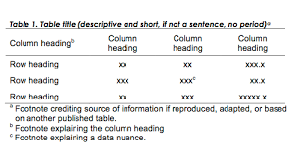
Dummy Table for all the objectives

